Slide 1
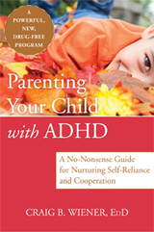
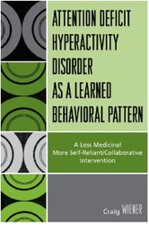
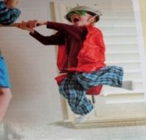
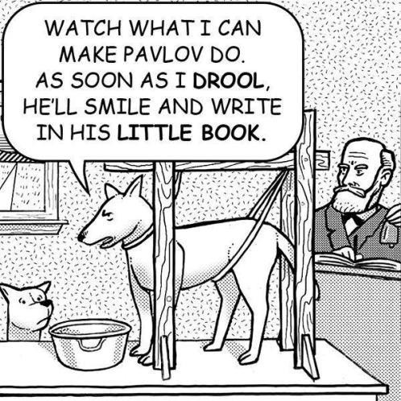
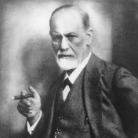
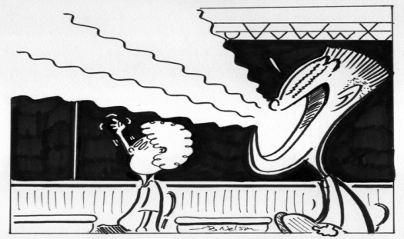
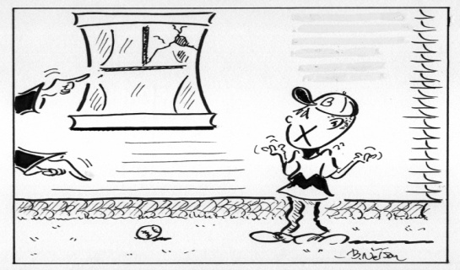
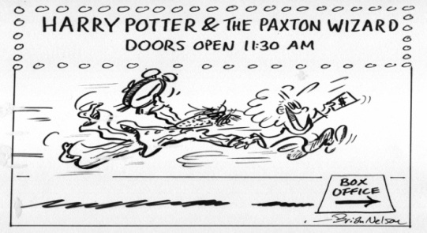
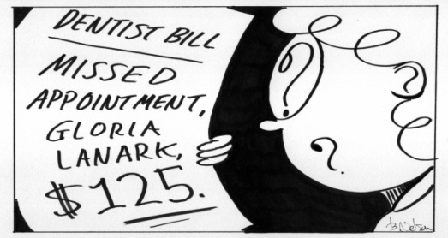
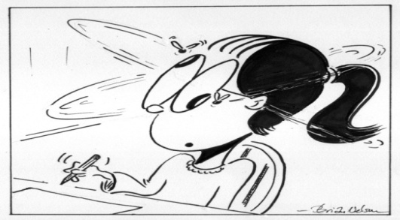
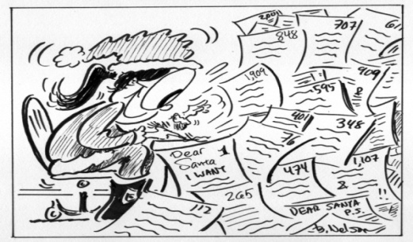
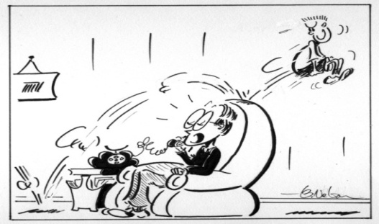
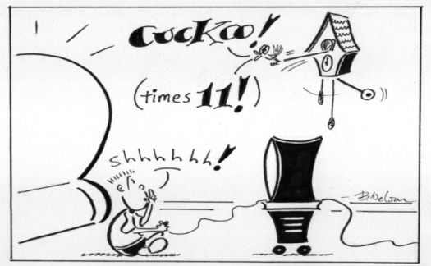
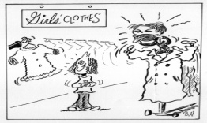
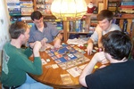
Helping Parents Nurture Self-Reliance and Cooperation in Children with ADHD
Craig B. Wiener Ed.D.
Private Practice/ University of Massachusetts Medical School/ Family Health Center of Worcester
Abstract
A Learning Paradigm For ADHD
Traditional Intervention
Based on Medication and Stringency
Key Benefits: Ease of Use and Rapid Results
Shortcomings
Ten Parenting Principles
Conclusions
It is now possible for concerned parents to treat their child’s attention deficit/hyperactivity disorder (ADHD) without relying on medication. This unique approach strengthens self-reliance and cooperation and helps parents reduce their child’s inattention, hyperactivity, and impulsivity.
Parents learn to interrelate in positive ways and identify the five main ways in which they may have unwittingly reinforced ADHD behavior in the past. Far from encouraging parents to strictly manage their child, this approach promotes independence in kids so that less stringency and surveillance is necessary.
The therapy works on the premise that ADHD behaviors increase in frequency due to reinforcement. Close examination of the child’s day-to-day patterning shows that the behaviors occur in particular situations and repeat in relation to what happens.
Parents learn to alter the consequences that increase the incidence of ADHD behavior, and promote cooperation and achievement by phrasing their requests in specific ways. The child’s preference is acknowledged so that working together is an attractive option. Coercion is kept to a minimum.
Ten parenting principles help to regulate emotions and develop the child’s executive functioning. The child learns the value of being knowledgeable without the motivation of punishment or gift rewards so that dependency on contingency management does not occur. The recommended strategies foster caring relationships, resiliency, and autonomy for children with ADHD.
Five Consequences that Reinforce ADHD Behavior
The Behaviors Are Situational and Have Psychological Meaning
Avoidance
Attention
Accommodation
Acquisition
Antagonism
With coercion the child may learn:
evasion/submission/anxiety/minimal conformity/retaliation/selfishness rigidity/domination/maneuvering procrastination/withholding/reliance
Blurting occurs when vying for attention or provoking
but not when there could be incrimination
Works Cited
Brooks, R. & Goldstein, S. (2001). Raising Resilient Children. New York. McGraw Hill.
Ehrenreich, J. T., Buzzella, B. A., & Barlow, D. H. (2007). General principles of the treatment of emotional disorders across the lifespan. In S. G. Hoffman & J. Weinberger (Eds.), The Art and Science of Psychotherapy. New York: Routledge. 191–210.
Freud, S. (1935). A General Theory of Psychoanalysis. Simon and Schuster.
Henry, W. P. Schacht, T. E., & Strupp, H. H. (1986). Structural analysis of social behavior: Application to a study of interpersonal process in differential psychotherapeutic outcomes. Journal of Consulting and Clinical Psychology. 54: 27-31.
Horvath, A. O., & Bedi, R.P. (2002) The alliance. In J. C. Norcross (Ed.), Psychotherapy relationships that work: Therapist contributions and responsiveness to patients. New York: Oxford University. 37-69.
Latham, G., Erez, M & Locke, E. (1988). “Resolving scientific disputes by the joint design of crucial experiments by antagonists: application to the Erez-Latham dispute regarding participation in goal setting”. Journal of Applied Psychology 73: 753–72.
Locke, E. A., and G. P. Latham. (2002). “Building a Practically Useful Theory of Goal Setting and Task Motivation.” American Psychologist. September: 705–17.
Martin, D. J., Garske, J. P., & Davis M. K. (2000). Relation of the therapeutic alliance with outcome and other variables: A meta-analytic review. Journal of Consulting and Clinical Psychology. 68: 438-450.
Wiener, C. Attention Deficit Hyperactivity Disorder as a Learned Behavioral Pattern: A Return to Psychology. (2007). Lanham, MD: University Press of America.
Wiener, C. Attention Deficit Hyperactivity Disorder as a Learned Behavioral Pattern: A Less Medicinal More Collaborative Intervention. (2007). Lanham, MD: University Press of America.
Wiener, C. Parenting Your Child with ADHD: A No-Nonsense Guide for Nurturing Self-Reliance and Cooperation. (2012). New Harbinger Publications.
It’s first in line for scheduled trips to the movies but unpleasant appointments are often missed
When Nurturing Self-Reliance and Cooperation
Parents help the child:
Recognize the pros and cons of particular behaviors
Identify positive alternative actions
Explore complications that might be encountered
Become aware of past successes in similar situations
Resolve problems that disrupt their relationship
Function adequately without parental involvement
Distractibility prevails when writing a “thank you” note
but not when writing a Christmas list
The Shortfalls of Biological Determinism
(1) ADHD is caused by genetics-
Too many false positives and false negatives
(2) Brain biology is different-
Correlated data not causal data
(3) Medicine works-
Treatment does not identify etiology
(4) ADHD is associated with functional delay-
No diagnostic markers
Hyperactivity occurs when parents are on the phone
but not if bedtime is extended while the parent talks
When does ADHD coping occur?
Situations associated with loss, restriction, and failure
When is ADHD unlikely?
Initiated and Enjoyed Activity
Craig Wiener, Ed.D.
508-756-4825
48 Cedar St.
Worcester, MA 01609
www.craigwiener.com

